Slide 1
EMPA-HEART CardioLink-6 Trial A randomized trial of empagliflozin on left ventricular structure, function and biomarkers in people with type 2 diabetes and coronary heart disease
Subodh Verma, C David Mazer, Andrew T Yan, David H Fitchett, Peter Jüni
Lawrence A Leiter, Deepak L Bhatt, Adrian Quan, Bernard Zinman & Kim A Connelly
University of Toronto, Toronto, ON, Canada
Embargoed until 10:45 a.m. CT/11:45 a.m. ET Sunday, Nov. 11, 2018

Slide 2
Disclosures
Subodh Verma reports the following:
Received speaking and/or research support from Abbott, Amgen, AstraZeneca, Bayer, Boehringer Ingelheim, Bristol-Myers Squibb, Eli Lilly, Janssen, Merck, Novartis, Novo Nordisk, Valeant, and Sanofi
National Coordinator for the DAPA-HF, DELIVER-HFpEF, EMPEROR-P, EMPEROR-R, SELECT, and SOLOIST trials
Scientific Excellence Committee of the EMPEROR-P and EMPEROR-R trials
Principal Investigator for the ACE, CAMRA, ENABLE-CP, NEWTON-CABG, and SEARCH-AF trials
Steering Committee CIRT, BELIEVE, SYNERGY
Canada Research Chair in CV Surgery (Tier 1)

Slide 3
EMPA-REG OUTCOME
Randomized 7,020 adults with
T2DM and established CVD (CAD, PAD or CVD)
Heart failure ~10%
A1C 7.0 to10.0%
eGFR ≥30 mL/min/1.73m²
Compared to placebo, the SGLT2i empagliflozin
14%↓
38%↓
Risk for
3-point MACE
CV death
32%↓
35%↓
All-cause
mortality
Hospitalization
for heart failure

Slide 4
Mechanism(s) Responsible for SGLT2i-associated
CV Benefits Remain Unclear
Natriuresis
Improved cardiac bioenergetics
Reduction in interstitial edema
SGLT2i and Prevention of CHF
Inhibition of cardiac sodium-hydrogen exchange
Reduced Preload and Afterload and reduction in LV wall stress
Improved renal function and cardiorenal physiology

Slide 5
Left Ventricular Mass (LVM) and CV Outcomes
LVM is a strong and independent predictor of major CV events - including CV and all-cause mortality, myocardial infarction, and heart failure
The magnitude of LVM regression correlates with the extent of clinical outcome benefit seen with pharmacological and device therapies
Cardiac MRI is the gold-standard to evaluate LVM

Slide 6
EMPA-HEART Study Objectives
Primary Objective
Secondary Objectives
To evaluate the impact of SGLT2 inhibition with empagliflozin on LV remodeling
To identify the pathophysiological mechanisms of empagliflozin-associated LV remodeling

Slide 7
Key Inclusion and Exclusion Criteria
Inclusion Criteria
Exclusion Criteria
≥40 and ≤ 80 years of age
History of T2DM
A1C ≥6.5% and ≤10 % within
3 months of the screening visit
Established CAD (prior coronary revascularization or history of MI)
Stable (≥2 months) background antihyperglycemic therapy
Using an SGLT2i, GLP-1RA, or saxagliptin
>4 incidents of moderate hypoglycemia per month or any episode of severe hypoglycemia
eGFR <60 mL/min/1.73 m²
LVEF <30%
NYHA Class IV or recent HHF

Slide 8
Trial Conduct and Timeline
423
Assessed for eligibility
271 Excluded
102 Not interested/declined participation
113 Ineligible per protocol
29 Excluded due to feasibility concerns
27 Investigator decision to exclude
48
Placebo
49
Empagliflozin
152
Consented
55 Screen Failure/Lost
27 Voluntary withdrawal
7 Screen Fail (eGFR< 60 mL/min/1.73m²)
13 Screen Fail (A1C <6.5% or >10.0%)
8 Screen Fail (other reasons)
Baseline
Cardiac MRI and Biomarkers
97
Randomized
1st randomization: Jan 6, 2017
7 Missing outcome data
1 Inability to undergo MRI
3 Refused follow-up MRI
1 Logistical error
2 Lost to follow-up
Month 6
Cardiac MRI and Biomarkers
Last participant visit: Sept 14, 2018

Slide 9
Statistical Plan
Primary Outcome
Primary Analysis
Change in LV mass (indexed to baseline BSA) at 6 months
Intention-to-treat population
Treatment effect was obtained using an ANCOVA adjusting for baseline LV mass
Secondary Outcomes
LV end-diastolic volume and end-systolic volume (indexed to baseline BSA) and ejection fraction
Biomarkers (NT-pro-BNP, Troponin I, sST2)

Slide 10
CMR Estimation of LV Volumes, Mass and EF
LV volumes, function and mass were calculated using CVi42 (circle imaging)
LV epicardium and endocardium were manually contoured by two blinded level 3 readers
Inter-observer variability was calculated in 20 random subjects (ICC = 0.995)
End Diastolic LV Contours

Slide 11
Baseline Demographics and Clinical History
 | Placebo (n=48) |  | Empagliflozin 10 mg (n=49)
Men | 46 | (96%) | 44 | (90%)
Age (years) | 63.5 | (10.1) | 62.2 | (7.8)
Body mass index (kg/m²) | 27.4 | (5.4) | 27.7 | (4.7)
Duration of T2DM (years) | 10.1 | (6.8) | 11.8 | (9.3)
Congestive heart failure | 4 | (8%) | 2 | (4%)
Hypertension | 43 | (90%) | 45 | (92%)
Nephropathy | 2 | (4%) | 0 | (0%)
Stroke and/or TIA | 6 | (13%) | 8 | (16%)
Peripheral artery disease | 3 | (6%) | 2 | (4%)
Smoking history | 22 | (46%) | 19 | (39%)

Slide 12
Baseline Medications and Laboratory Results
 | Placebo (n=48) |  | Empagliflozin 10 mg (n=49)
Metformin | 44 | (92%) | 47 | (96%)
Insulin | 12 | (25%) | 12 | (25%)
Statin | 46 | (96%) | 47 | (96%)
ACEi/ARB | 41 | (85%) | 40 | (82%)
Diuretic | 6 | (13%) | 2 | (4%)
β-blocker | 39 | (81%) | 38 | (78%)
Calcium channel blocker | 15 | (31%) | 6 | (12%)
Antiplatelet agent | 41 | (85%) | 40 | (82%)
A1C (%) | 8.0 | (0.9) | 7.9 | (0.8)
Systolic blood pressure (mmHg) | 135 | (20) | 134 | (21)
Diastolic blood pressure (mmHg) | 76 | (11) | 77 | (12)
LDL-C (mg/dL) | 53 | (26) | 57 | (28)
eGFR (mL/min/1.73m²) | 88 | (18) | 87 | (16)
LVMI | 62.2 | (12.8) | 59.3 | (10.9)
NTproBNP (pg/mL) | 204.5 | (274.3) | 145.4 | (152.6)

Slide 13
Empagliflozin Treatment Lowers Ambulatory Blood Pressure (ABPM)
Systolic Blood Pressure
Diastolic Blood Pressure
Baseline SBP (mmHg) | 138.4 |  | 139.3
Baseline DBP (mmHg) | 78.5 |  | 79.7
0.8
-0.7
-2.0
-7.9
Adjusted difference (95% CI)
between groups
-6.78 (-11.23, -2.32)
P = 0.003
Adjusted difference (95% CI)
between groups
-2.07 (-5.38, 1.25)
P = 0.22

Slide 14
Empagliflozin Treatment Increases Hematocrit
Baseline hematocrit (%) | 41.3 |  | 42.4
2.4
0.4
Adjusted difference (95% CI) between groups
1.91 (0.58, 3.24)
P = 0.006

Slide 15
Primary Outcome Empagliflozin Reduces LVMIª
Adjusted difference (95% CI) between groups
-3.35 (-5.9, -0.81)
P = 0.01
Baseline LVMIª (g/m²) | 62.2 |  | 59.5
-0.01
-2.6
LVM regression (g) | -0.39 (10.83) |  | -4.71 (15.43)

Slide 16
Sensitivity Analysis (LVM Regression)
LVM indexed to height P=0.03
LVM indexed to height^{1.7} P=0.02
LVM indexed to height^{2.7} P=0.01
LVM indexed to weight P=0.005

Slide 17
Pre-specified Subgroup Analysis by Baseline LVMI
Baseline LVMIª | Adjusted Difference Between Groups (95% CI) |  | P_{Interaction}
≤60 g/m² | -0.46 (-3.44, 2.52) |  | 0.007
>60 g/m² | -7.26(-11.4, -3.12)

Slide 18
Secondary cMRI Outcomes
LVESVIª
LVEDVIª
LVEF
Baseline LVESVIª (mL/m²) | 32.3 |  | 27.3
Baseline LVEDVIª (mL/m²) | 71.4 |  | 63.3
Adjusted difference (95% CI)
between groups
2.21 (-0.23, 4.66)
P = 0.07
Adjusted difference (95% CI)
between groups
-1.20 (-3.77, 1.37)
P = 0.36
Adjusted difference (95% CI)
between groups
-1.16 (-4.99, 2.66)
P = 0.55
Baseline LVEF (%) | 55.5 |  | 58.0
2.2
0.04
-1.6
-2.1
-0.01
-1.0

Slide 19
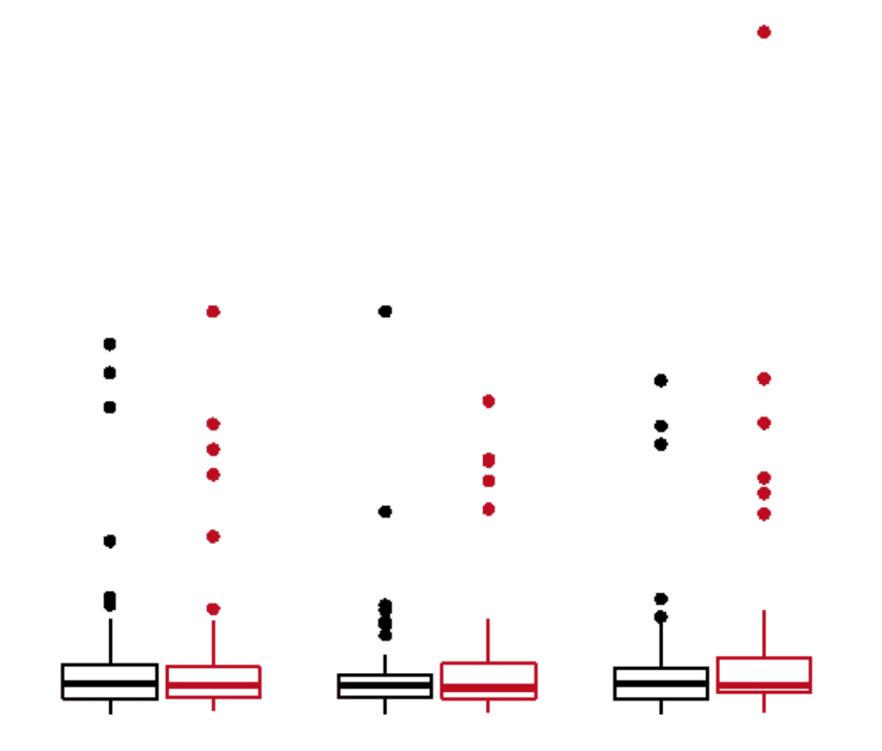
NT-proBNP, Troponin I and Soluble ST2 Levels were Unaffected by Empagliflozin Therapy
NT-proBNP
Troponin I
Soluble ST2
Log baseline NT-proBNP (pg/mL)
Placebo 221.5 (274.3)
Empagliflozin 152.3 (152.6)
Log baseline Troponin I (ng/L)
Placebo 103.9 (179.7)
Empagliflozin 161.1 (259.1)
Log baseline Soluble ST2 (pg/mL)
Placebo 6028.4 (8697.4)
Empagliflozin 5975.4 (8632.0)
3000
6
Adjusted difference (95% CI)
between groups
0.12 (-0.1, 0.33)
P = 0.28
1000
Adjusted difference (95% CI)
between groups
-0.10 (-0.34, 0.13)
P=0.38
Adjusted difference (95% CI)
between groups
0.08 (-0.17, 0.32)
P=0.53
2000
NT-proBNP (pg/mL)
Troponin I (ng/L)
4
sST2 x 10⁴ (pg/mL)
1000
500
2
0
0
0
Baseline
Month 1
Month 6
Baseline
Month 1
Month 6
Baseline
Month 1
Month 6
● Placebo
● Empagliflozin

Slide 20
Adverse Events Associated with Empagliflozin Therapy for 6 Months
 | Placebo (n=48) |  | Empagliflozin 10 mg (n=49) |  | P value
≥ 1 AE | 27 | ( 56.2) | 28 | (57.1) | >0.99
≥ 1 SAE | 1 | (2.1) | 3 | (6.1) | 0.62
≥ 1 AESI (decreased renal function) | 0 | (0.0) | 1 | (2.0) | >0.99
Discontinuation due to an AE | 3 | (6.2) | 4 | (8.2) | >0.99
Hypoglycemia | 0 | (0.0) | 0 | (0.0) | —
Hypovolemia | 0 | (0.0) | 0 | (0.0) | —
Metabolic acidosis, ketoacidosis or diabetic ketoacidosis | 0 | (0.0) | 0 | (0.0) | —
Heart failure | 0 | (0.0) | 0 | (0.0) | —
Hospitalization for heart failure | 0 | (0.0) | 0 | (0.0) | —
Myocardial infarction | 0 | (0.0) | 0 | (0.0) | —
Revascularization | 0 | (0.0) | 0 | (0.0) | —
Stroke | 0 | (0.0) | 0 | (0.0) | —
Death from cardiovascular causes | 0 | (0.0) | 0 | (0.0) | —
All-cause deaths | 0 | (0.0) | 0 | (0.0) | —

Slide 21
Strengths and Limitations
Strengths
Limitations
Balanced and representative ASCVD population
Use of gold standard cMRI
Physiologic and biologic examinations
Small sample size
Short follow-up
Stable and well treated CAD population without marked LVH at baseline, low BNP and without HF

Slide 22
EMPA-HEART in Context
Aliskiren in Left Ventricular Hypertrophy (ALLAY) Trial
N=111 with diabetes
Baseline SBP 148±14 mmHg
44 week follow up

Slide 23
Summary I
Empagliflozin and LVMIª
In individuals with T2DM, and a history of stable CAD, empagliflozin 10 mg QD for 6 months significantly reduced LV mass compared with placebo
These benefits were seen in a normotensive population, with preserved ejection fraction, without known heart failure, and on top of standard of care therapies (with ≥80% on RAS blockers), and were greater in those with higher baseline LVMI

Slide 24
Summary II
Empagliflozin treatment was associated with a significant reduction in ambulatory systolic blood pressure and elevation in hematocrit levels
Baseline NT-proBNP, Troponin I and sST2 levels were low in this cohort and remain unaffected by empagliflozin

Slide 25
Conclusion
These data suggest that the SGLT2i, empagliflozin, promotes early, statistically and clinically significant reverse remodeling which may contribute to the CV and HF benefits observed in the EMPA-REG OUTCOME trial and other SGLT2i studies.

Slide 26
Acknowledgement
Supported through an unrestricted investigator-initiated grant from Boehringer Ingelheim

Slide 27
Ronald M Goldenberg
Shaun G Goodman
Michael E Farkouh
David W H Dai
Hwee Teoh
Andrew Liuni
Anna Slabiak
Olugbenga O Bello
Subodh
Verma
C David
Mazer
Andrew T
Yan
Arun Partridge
‎‎Christopher Bonneau
Ehab Bakbak
Natasha Dhingra
Andrew H Williams
Sai G Lambotharan
Naveen Gupta
David H
Fitchett
Lawrence A
Leiter
Peter
Jüni
Deepak L
Bhatt
Tamique Mason
Erika Opingari
Vinay Garg
Biswajit Chowdhury
Adrian
Quan
Bernard
Zinman
Kim A
Connelly

